Slide 1
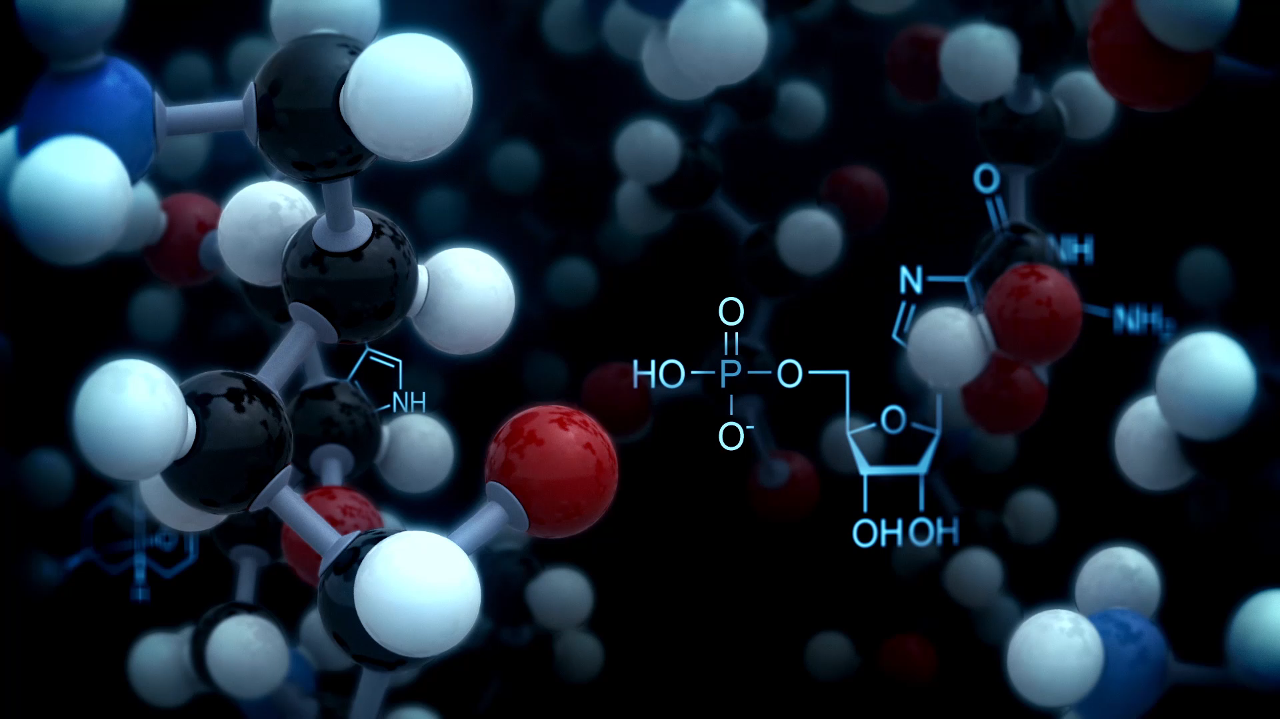
Molecular Ecology in Entomology
Research Skills in Entomology
11/07/24
Simon Segar
ssegar@harper-adams.ac.uk

Slide 2
Contents
Molecular tools (a working summary based on my experience)
Applications for entomology
Population genetics
DNA barcoding
Molecular phylogenetics

Slide 3
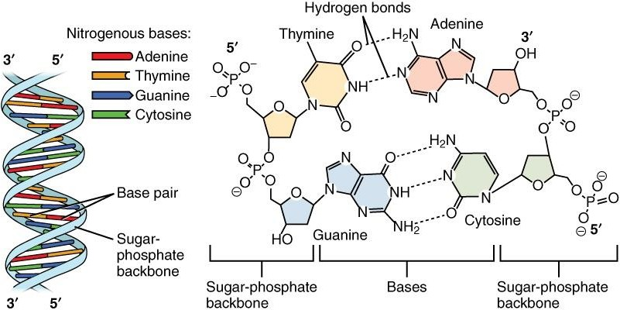
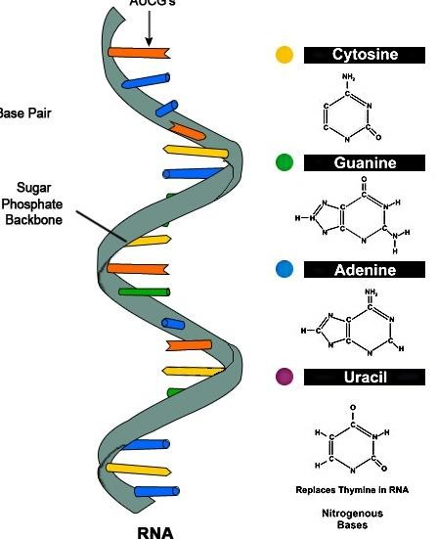
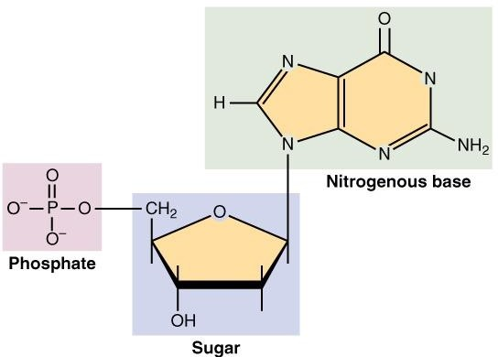
DNA and RNA

Slide 4
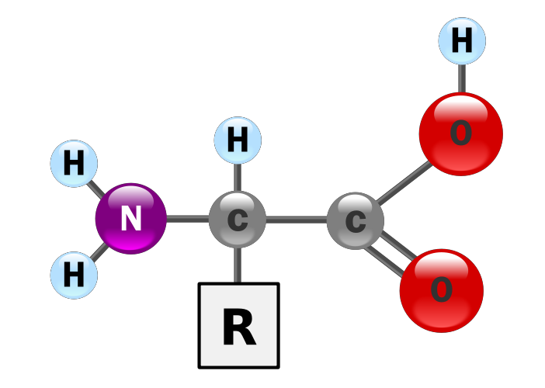
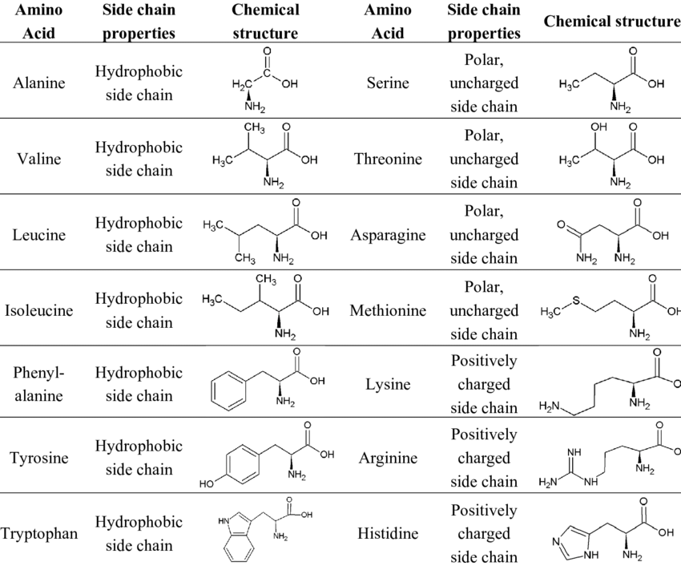
Proteins

Slide 5
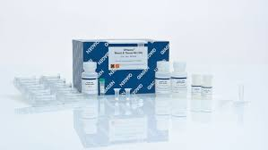
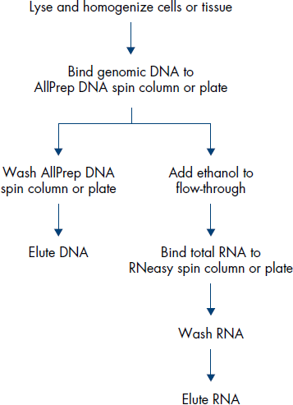
Key Techniques: DNA Extraction

Slide 6
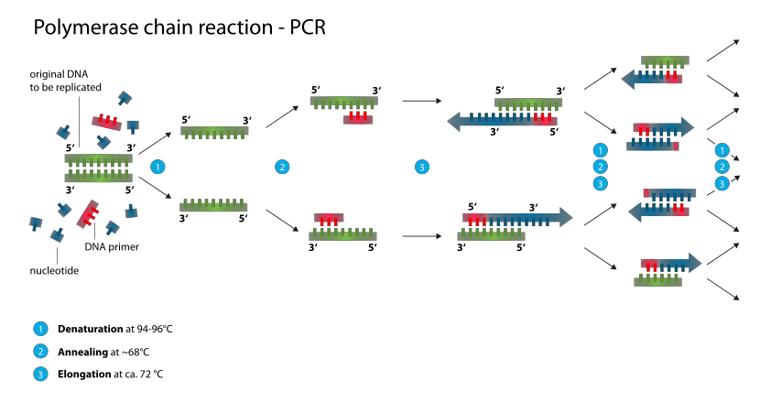
Key Techniques: PCR

Slide 7
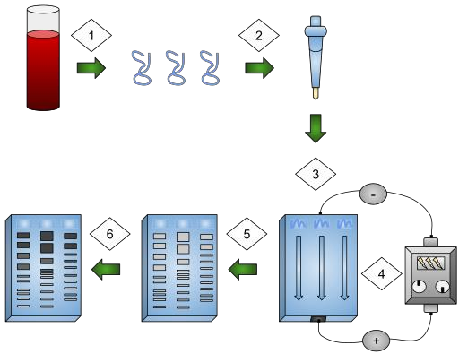
Key Techniques: Gel electrophoresis

Slide 8
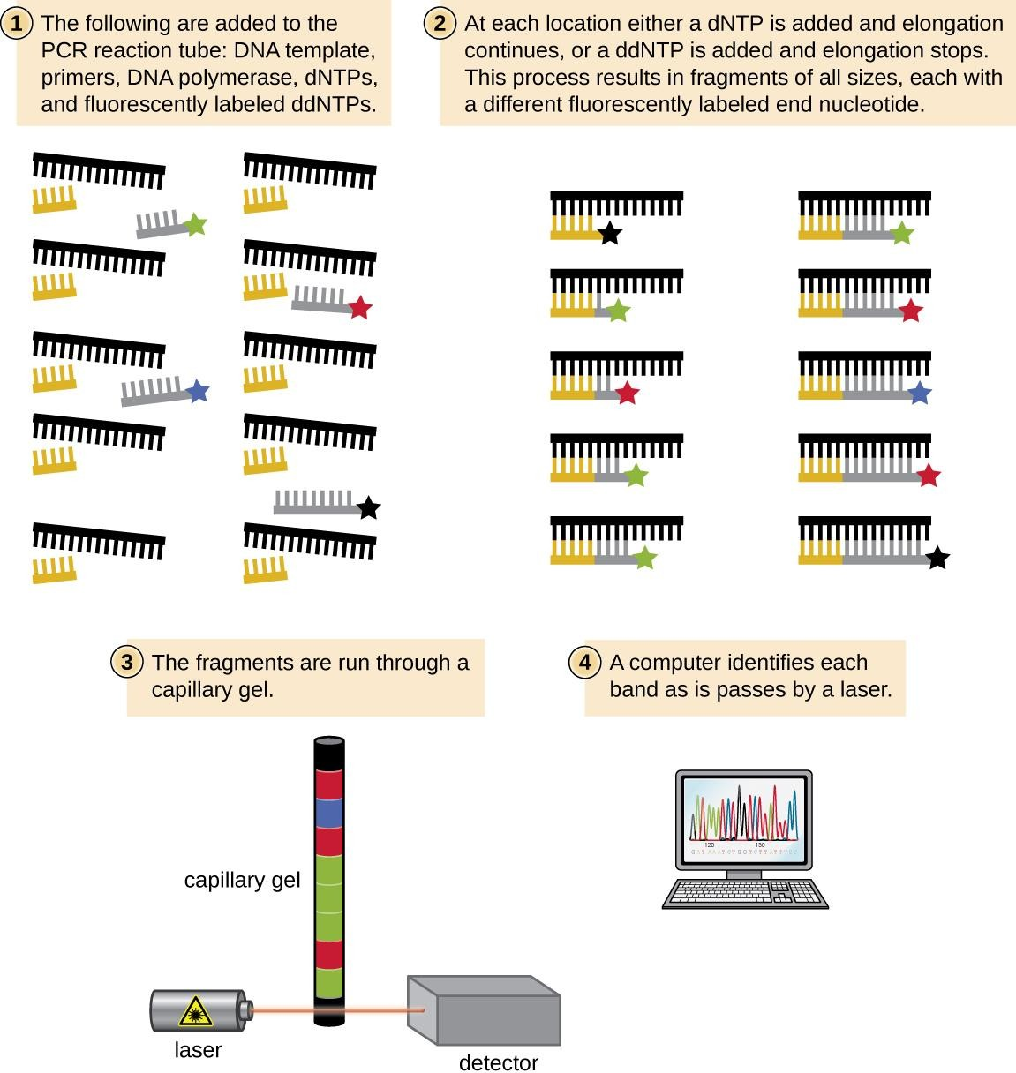
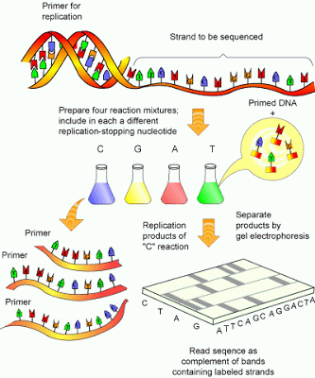
Key Techniques: Sanger Sequencing

Slide 9
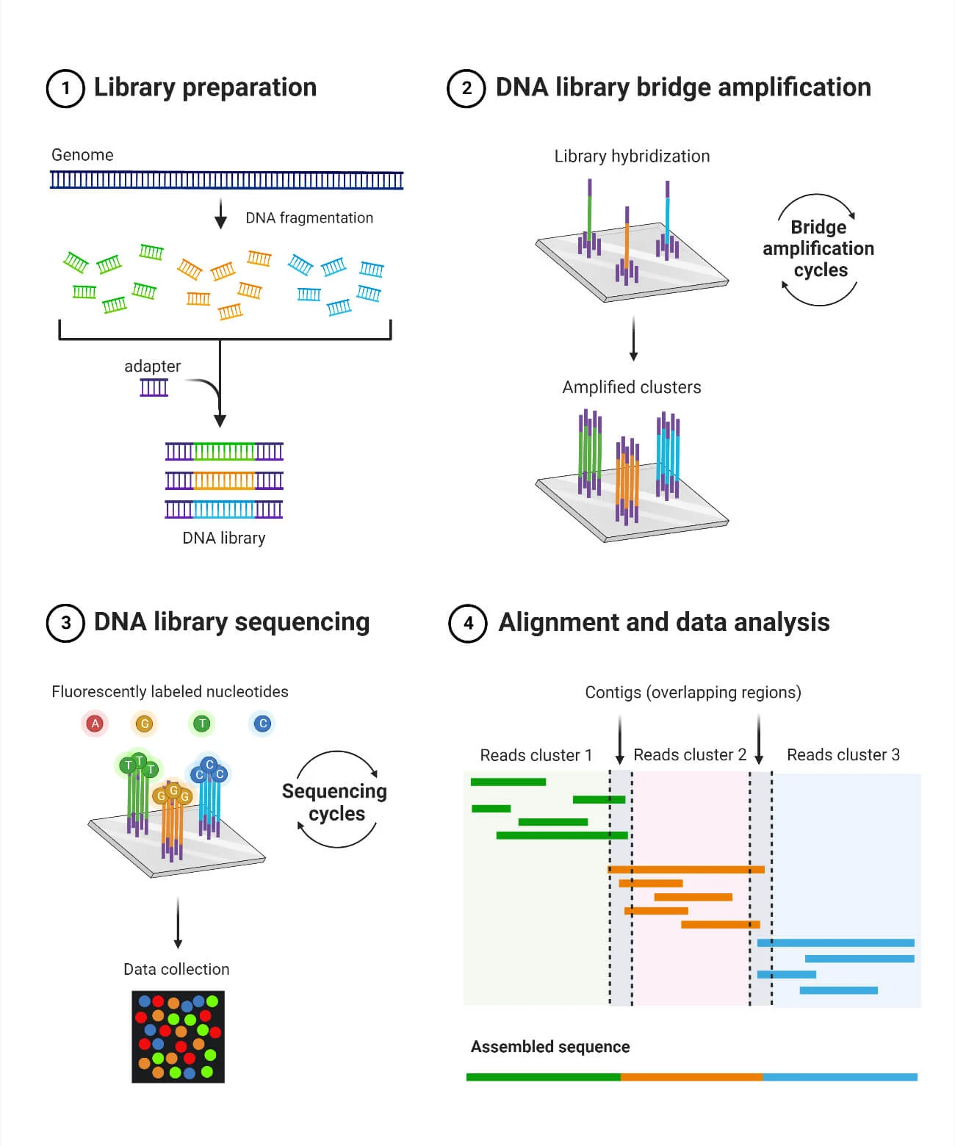
Key Techniques: Illumina Sequencing

Slide 10
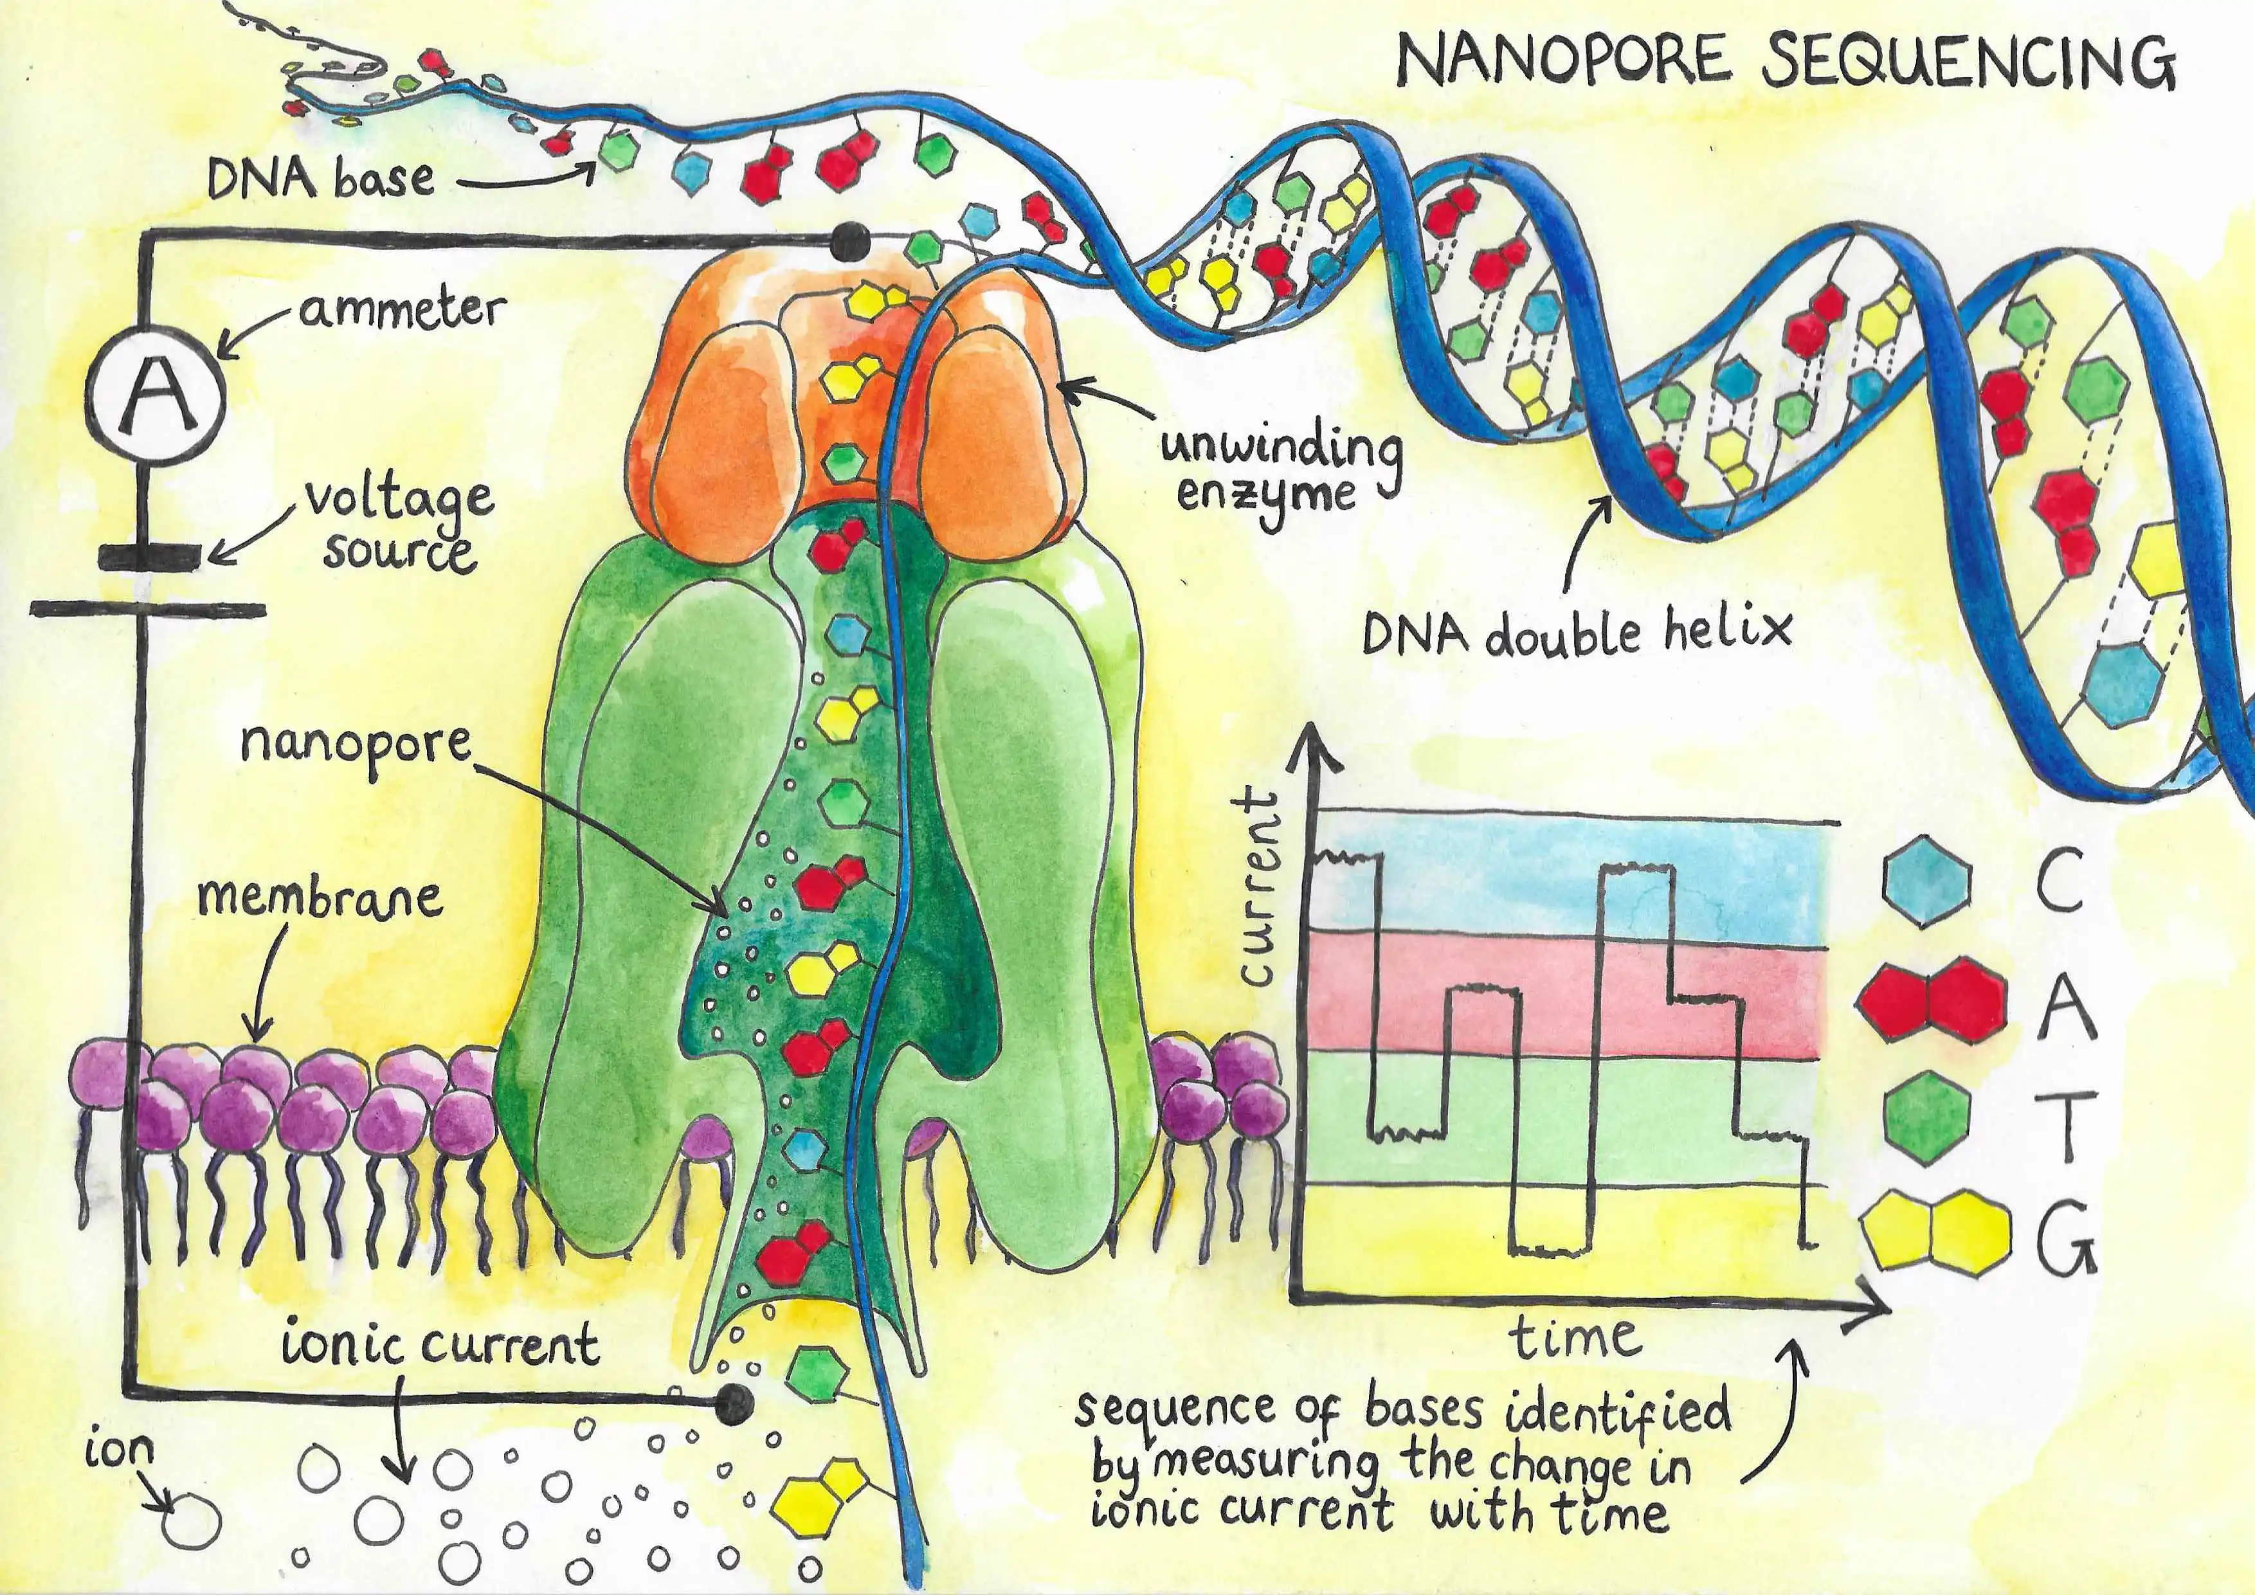
Key Techniques: Nanopore Sequencing

Slide 11

Don’t forget that these are tools. Good science is underpinned by observations and questions, embedded in solid theory and predictions. It requires tools but is not built around them.

Slide 12
The onion of Molecular Ecology
Biogeography and macroevolution
Whole genome phylogenetics
Population genetics/genomics
Metagenomics
Microevolution
Single cell genomics

Slide 13
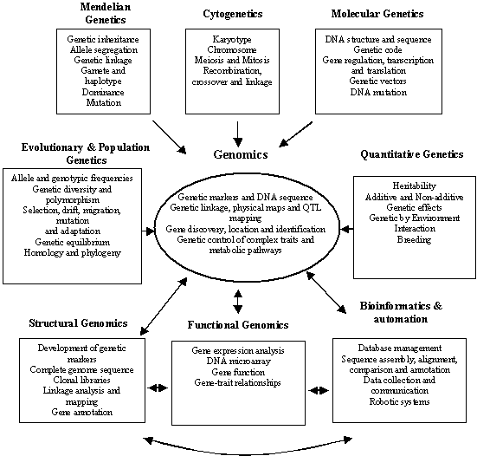

Slide 14
Population Genetics I
Microevolution: change in gene frequency within a population.
Allelic diversity underpins adaptation.
Useful for calculating effective population size

Slide 15
Population Genetics II
Relies on molecular markers (polymorphisms in individuals within populations)
Generally, we are interested in gene flow and deviations from Hardy-Weinberg (see the vast body of literature emerging from the ‘modern synthesis’)
Changes in population size over time, conservation genetics and gene mapping etc.

Slide 16
Markers and more markers
Dominant (two alleles) and codominant (many alleles)
Anonymous (not under selection these neutral markers conform to assumptions under Hardy-Weinberg (e.g., SSRs) are not under selection
Parental assignment, gene flow and marker aided selection etc.
Genic (specific region, usually a transcribed gene)
Bi-parental or uniparental (e.g., mtDNA)

Slide 17
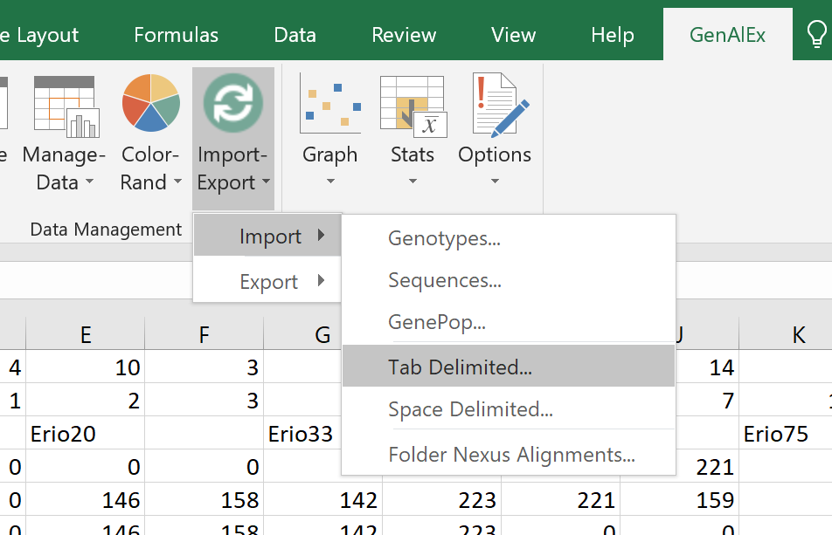
Give it a go…

Slide 18
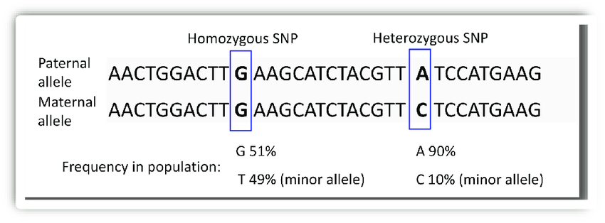
SNPs
Single nucleotide polymorphisms

Slide 19
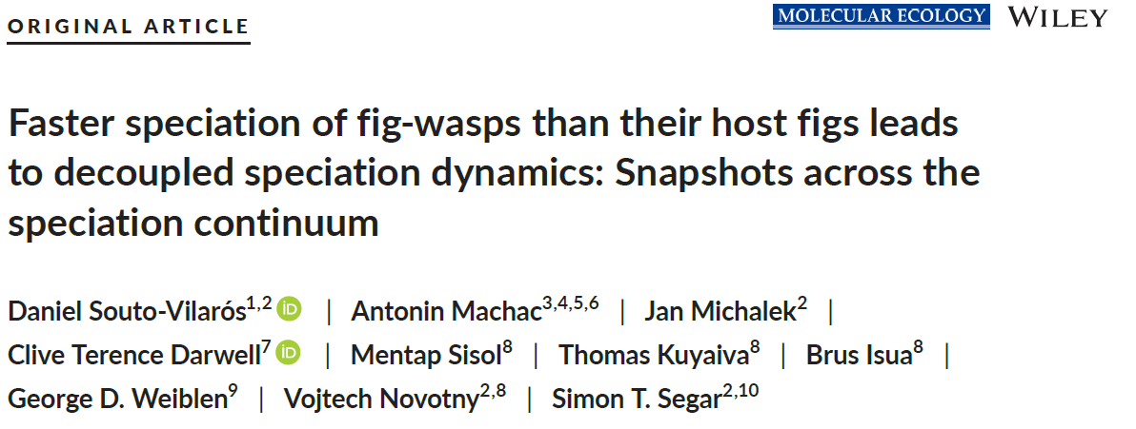
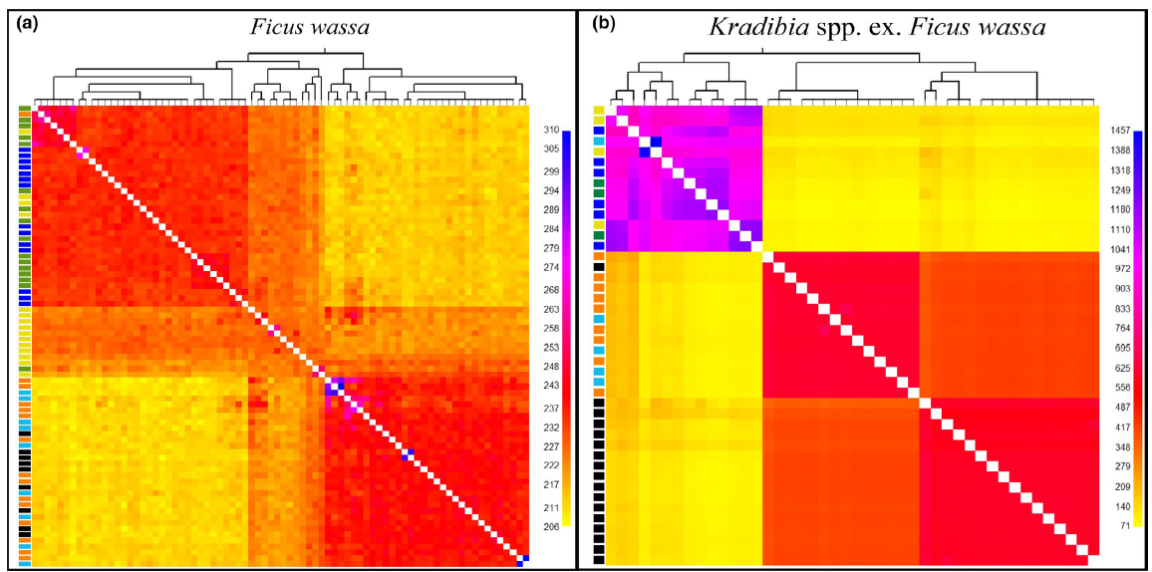

Slide 20
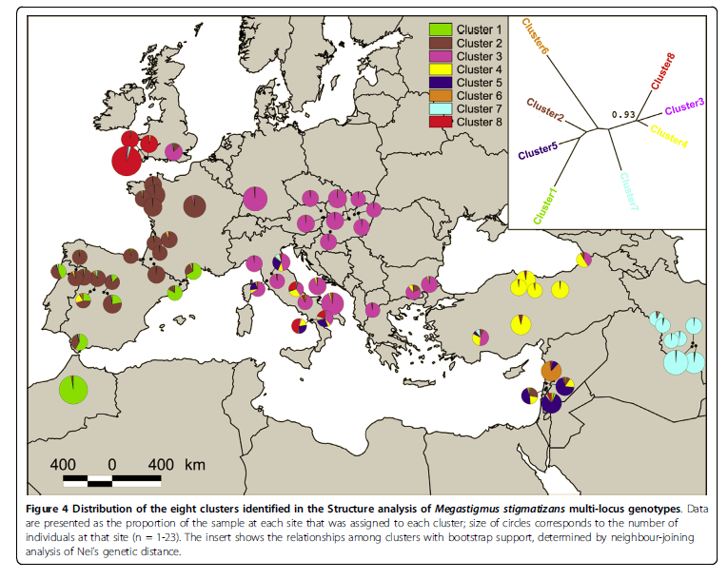
Phylogeography
How have historical processes shaped extant distributions of species?
Approach and markers bridge gap between population genetics and phylogeny

Slide 21
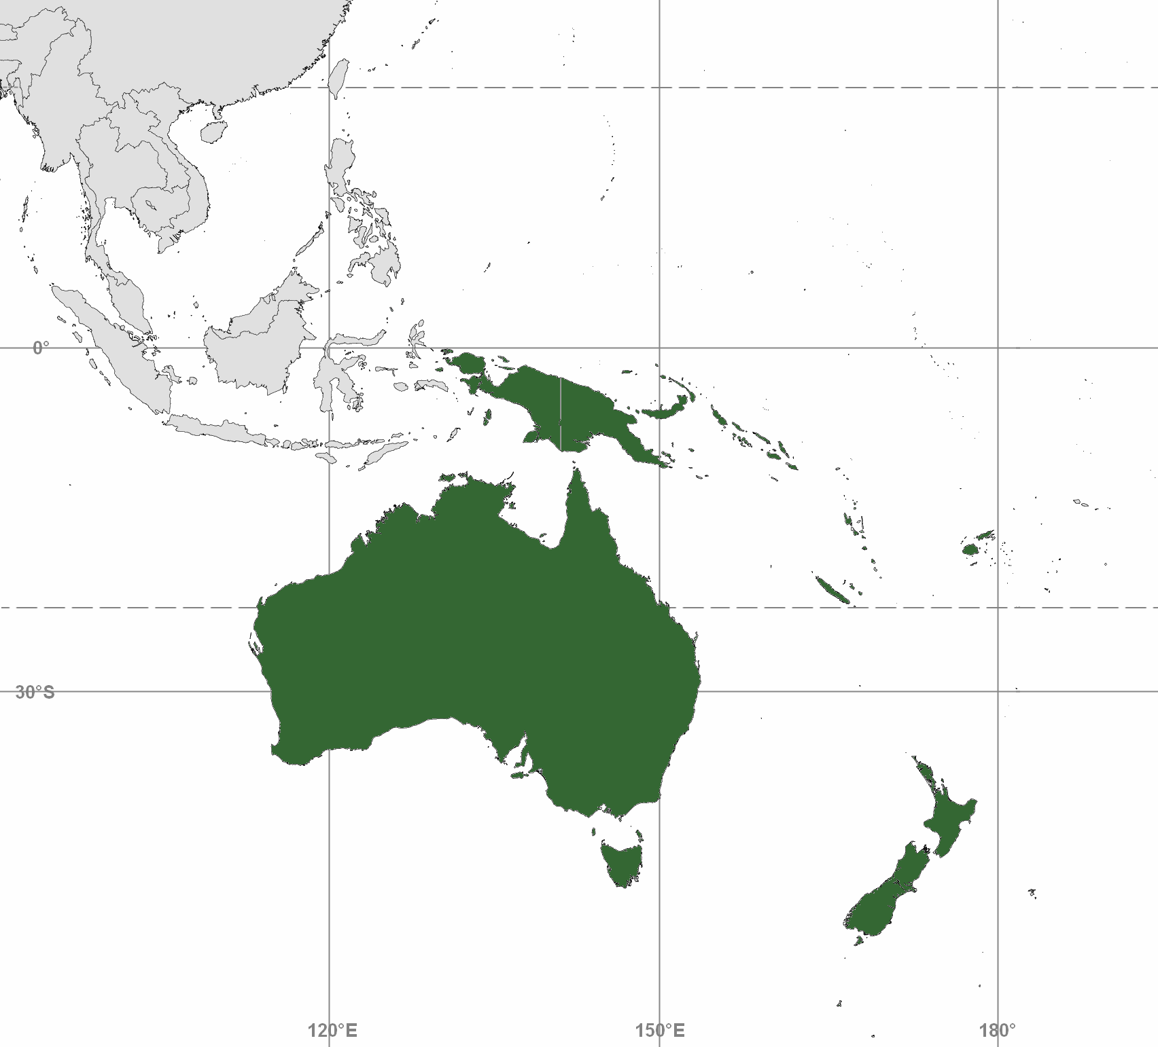
4 MYA
0.6 MYA
7 MYA

Slide 22
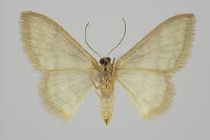
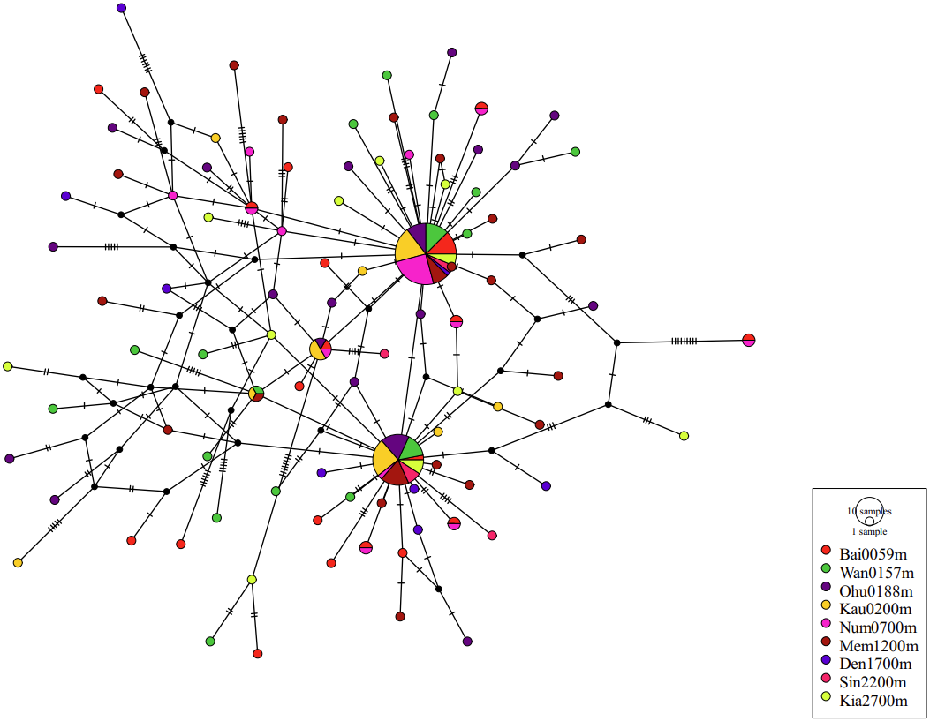
COI Haplotype Network Idaea simplex at Mt Wilhelm by Sentiko Ibalim

Slide 23
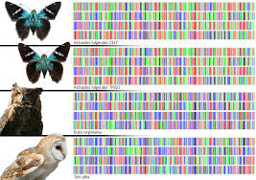
DNA Barcoding
Even low estimates of insect diversity surpass what we have described (e.g. only one million or so species described vs. an average of around six million predicted).
Need for ‘turbo taxonomy’
DNA barcoding provides a rapid and standardised approach to creating an inventory of insect life and fast tracking alpha taxonomy
Distinction between species identification and species delineation (latter seeks explore genetic boundaries of a new taxon)

Slide 24
Species identification vs. species delineation
Identification: provisional assignment of a species name to a specimen => our focus is on identification, but we will cover delineation
Delineation: exploring the evolutionary boundaries of a new taxa

Slide 25
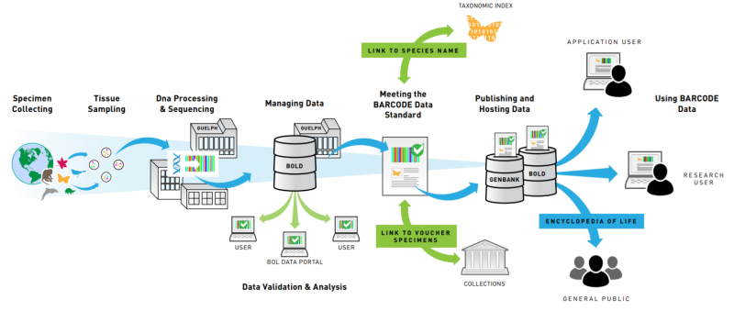

Slide 26
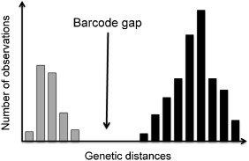
How does it work?
Sequencing of a 658 bp long section of the cytochrome oxidase 1 (COI) gene.
Sequences from non-breeding sister taxa are typically greater than 2% different in terms of base composition: gap between intra- and inter-specific variation
Mitochondrial gene, evolves rapidly and subject to high levels of genetic drift (only inherited from one parent)
Smaller effective population size
Hubert and Hanner, 2015. DNA Barcodes.

Slide 27
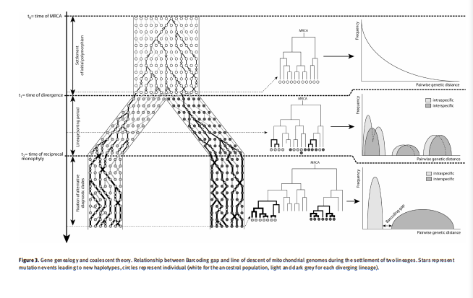
Mind the ‘barcoding’ gap

Slide 28
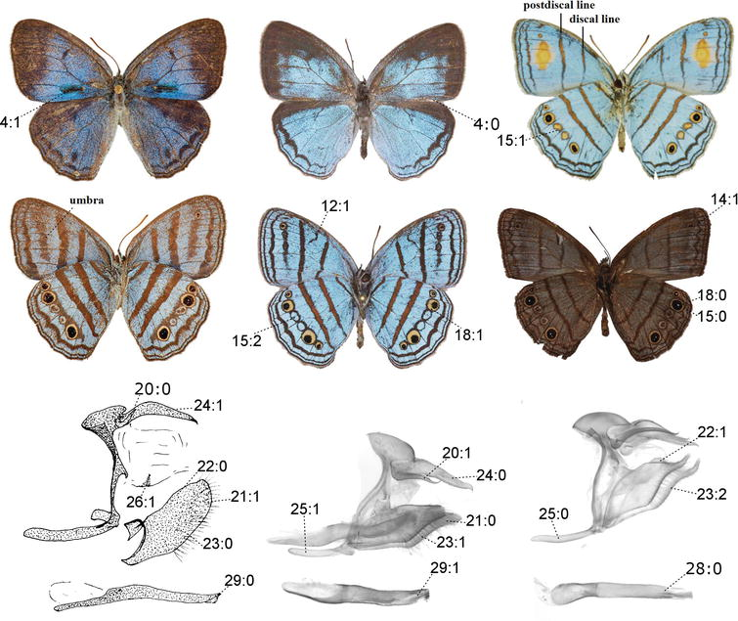
Here today, gone tomorrow?
Evidence for insect declines, while mixed and with a strong temperate bias, shows that we are loosing species faster than we can describe them!
Discussion points:
Species inventory
Morphospecies
Connecting biotas
Phylogeography
Metabarcoding
Linking sexes
eDNA
Caeruleuptychia (Lepidoptera, Nymphalidae, Satyrinae)
Saunders et al., 2020. BioScience.

Slide 29
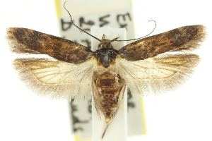
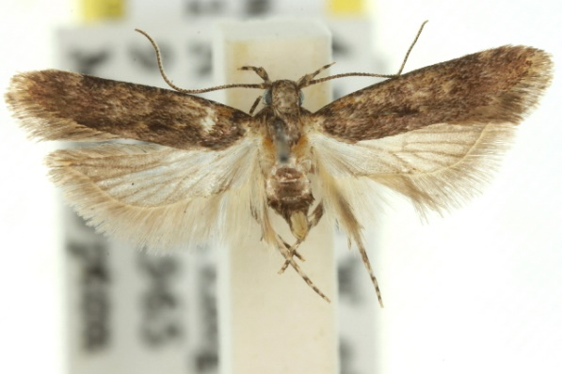
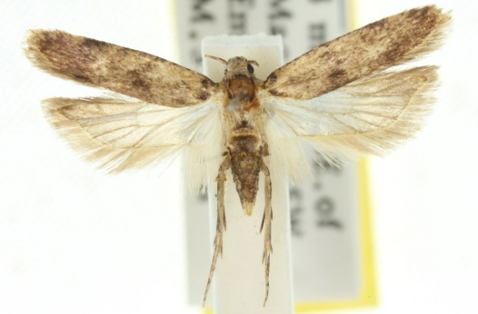
Why species ID is critical to understanding ecology and conservation?
Species identification is central in biological control programmes, disease prevention and diagnosis (e.g. pink cotton boll worm)
Eastern Australia
Native Hibiscus (Malvaceae), not a pest
Western Australia
Serious pest of Gossypium spp. (cotton)
Pectinophora gossypiella
Pectinophora endema
QLD Australia, PNG, Micronesia and Hawaii
Doesn’t diapause in cotton (minor pest)
Larval morphology and adult genitalia used for ID. Quarantine efforts focused on keeping Pectinophora gossypiella out of Queensland at great cost to government and industry.
Pectinophora scutigera

Slide 30
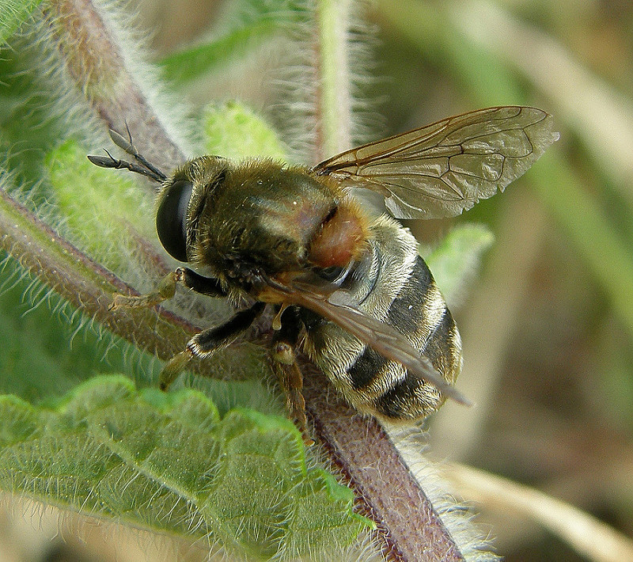
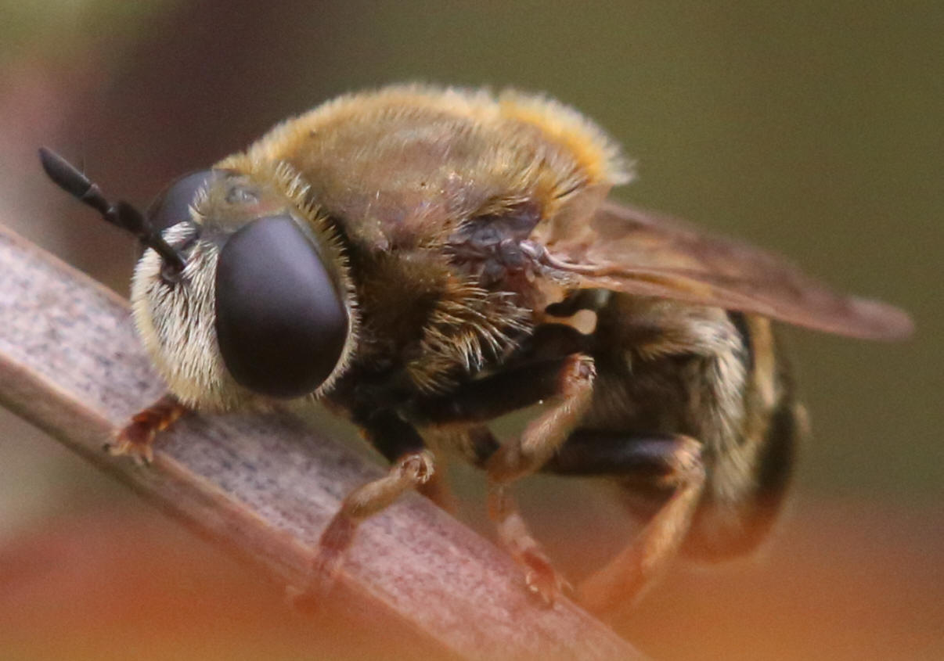
Why species ID is critical to understanding ecology and conservation?
Microdon myrmicae
Microdon mutabilis
Identified as two obligate social parasites of ants with different ant hosts: one rare species became two endangered species.
Schonrogge et al., 2002. Biol. J. Linn. Soc.

Slide 31
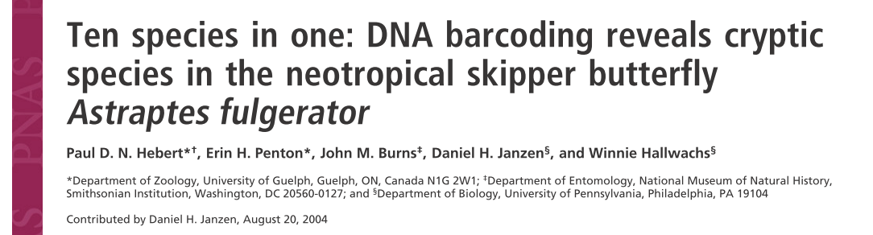
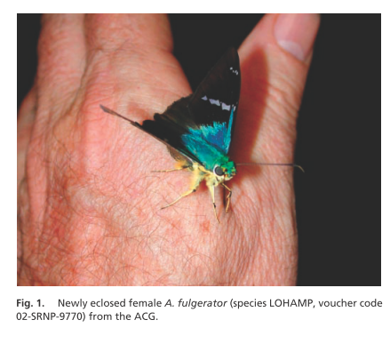
Cryptic species and DNA barcoding
Tropical invertebrates are particularly understudied and many cryptic species have been discovered.
Researchers used DNA barcoding in combination with traditional morphology to assign species ID
Barcoding of gut content can even reveal interactions that are hard to observe or measure
(e.g. plant DNA in insect guts).
Hebert et al., 2004.

Slide 32
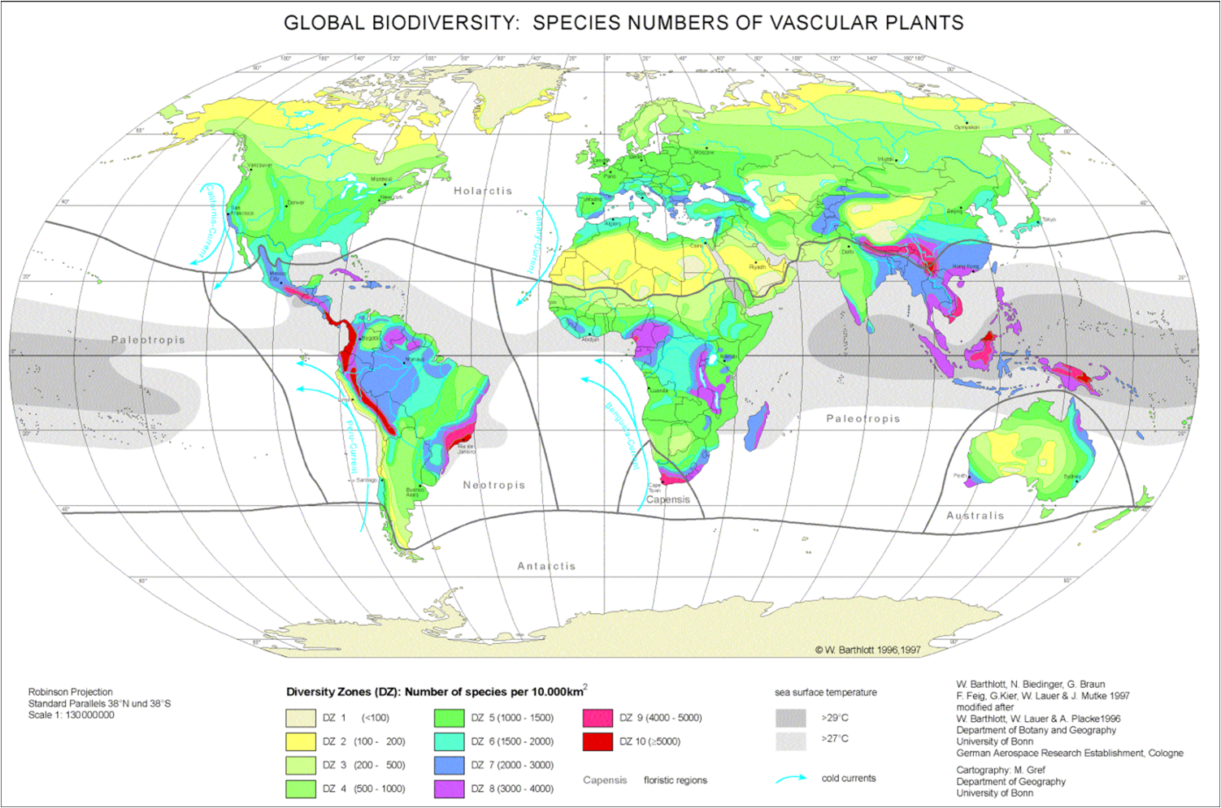
Less than 0.5% of the Worlds Land Mass, 5% of its species found in Papua New Guinea!

Slide 33
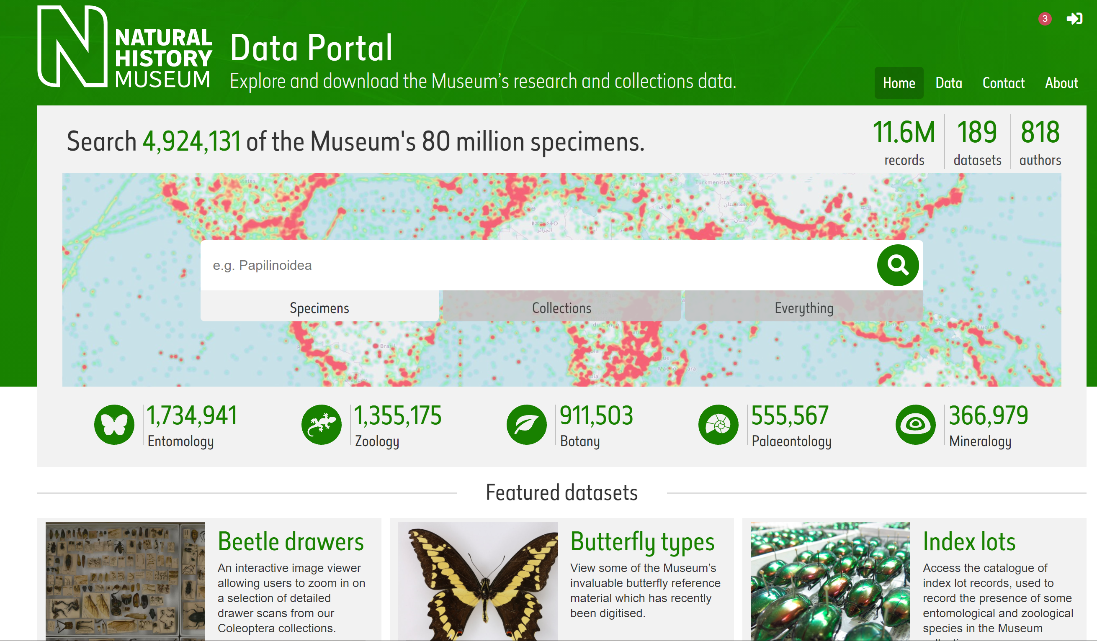
Specimen curation (electronic data)
https://www.nhm.ac.uk/our-science/data.html

Slide 34

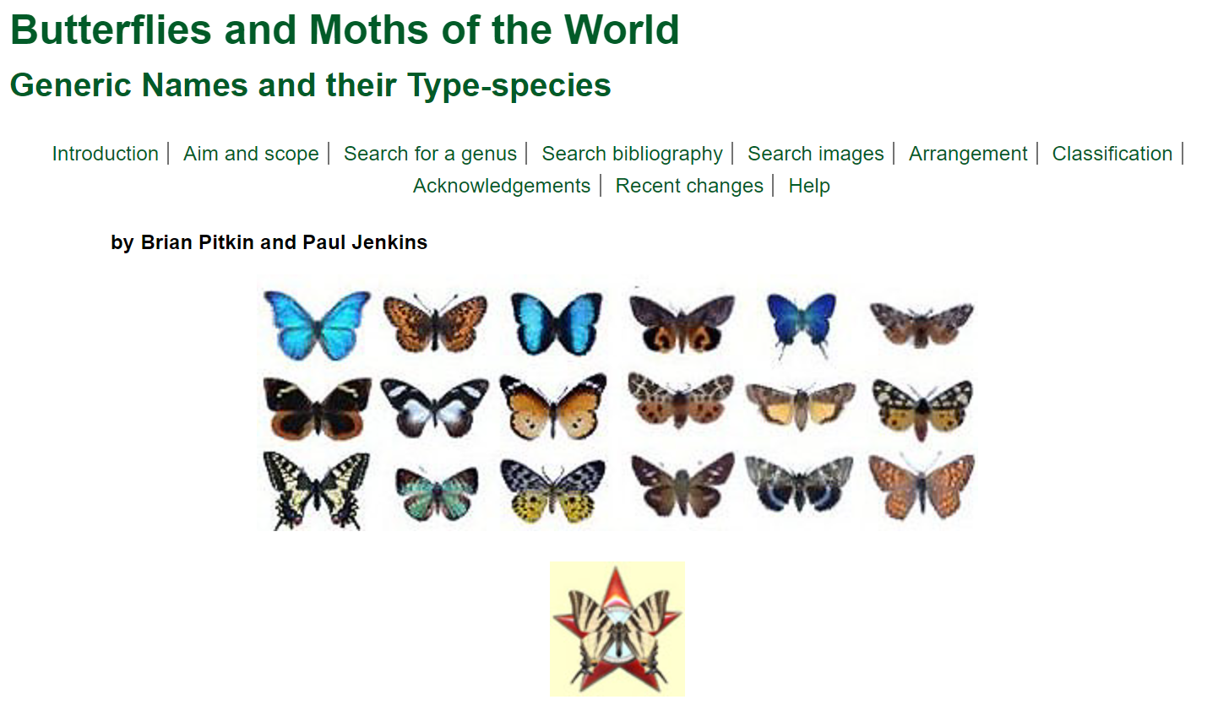

Slide 35

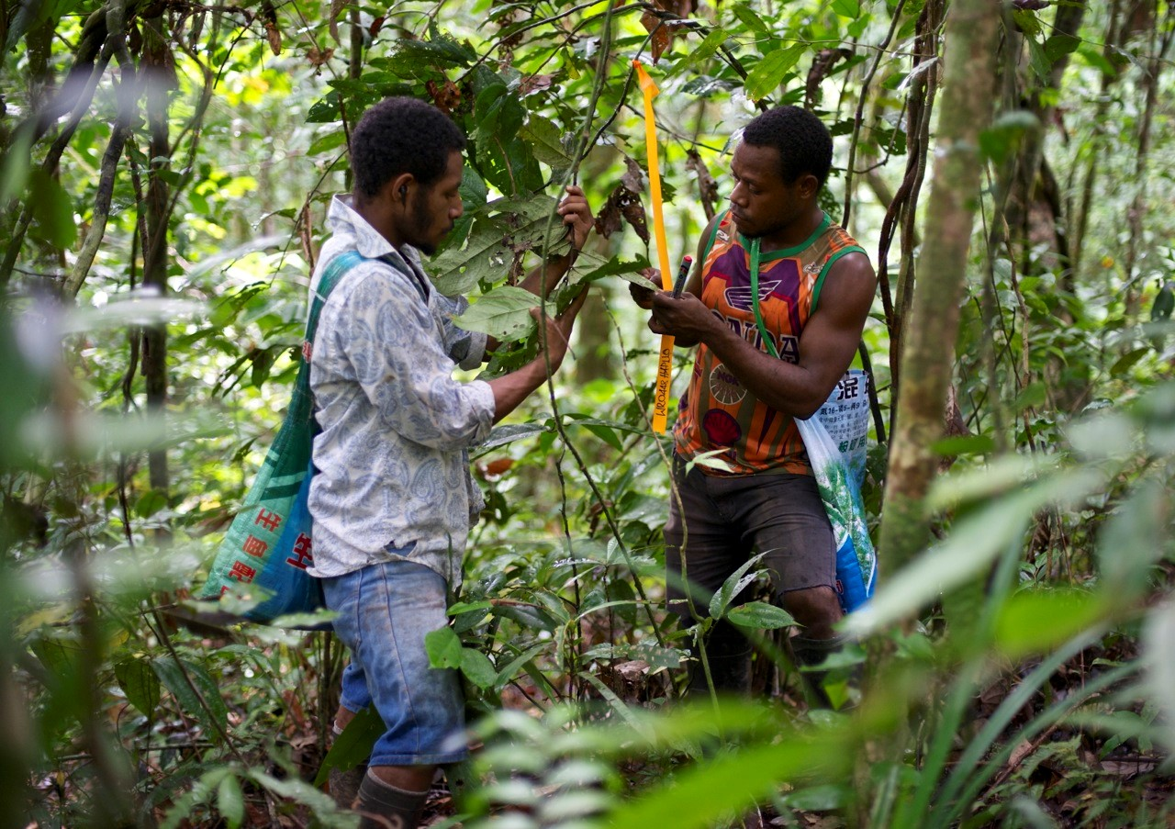
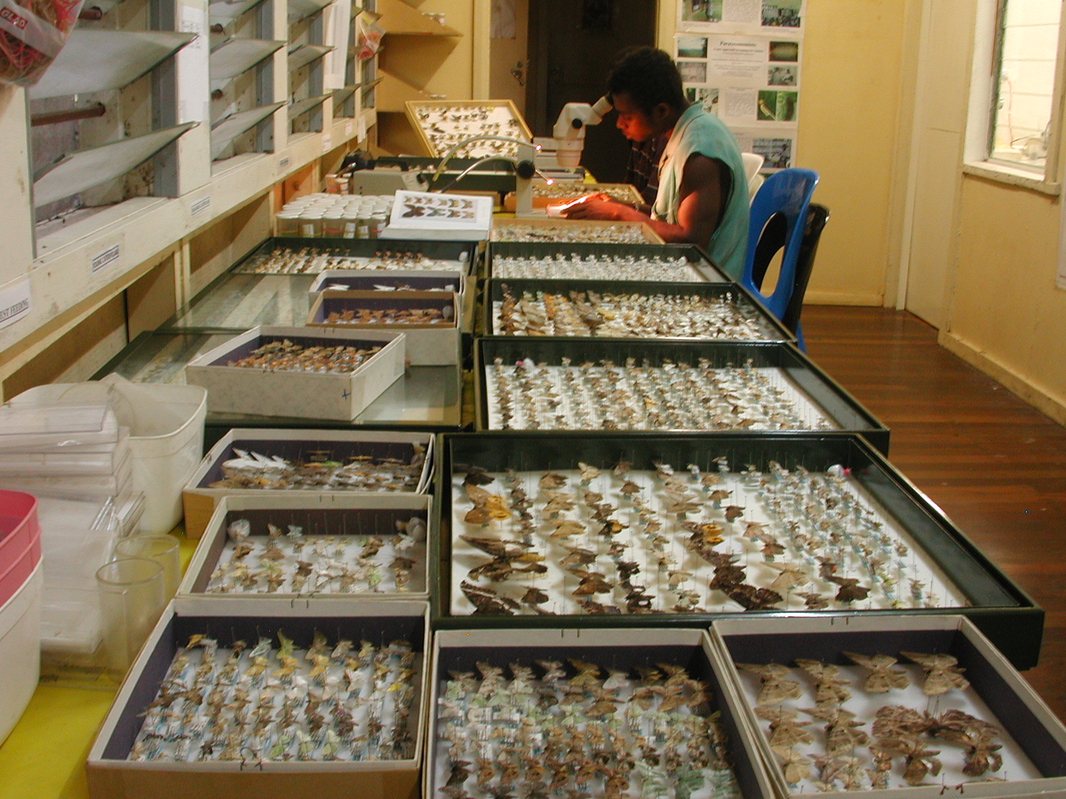
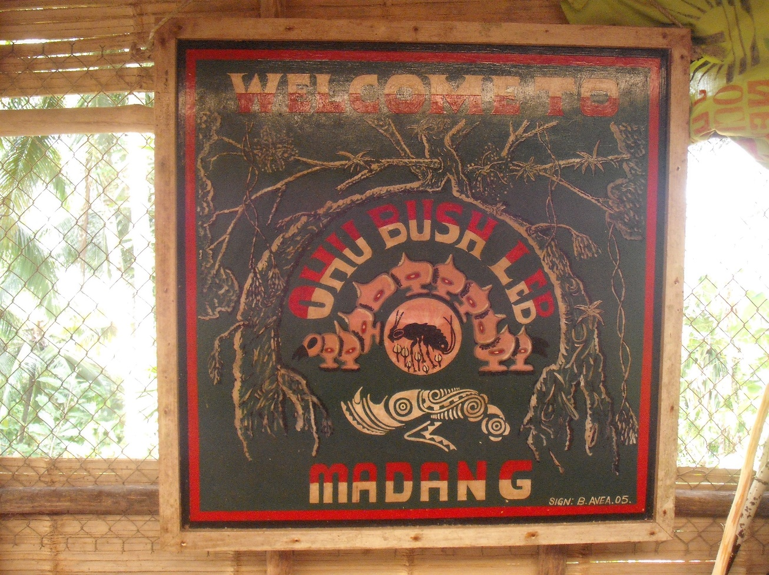
The New Guinea Binatang Research Centre

Slide 36
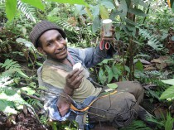
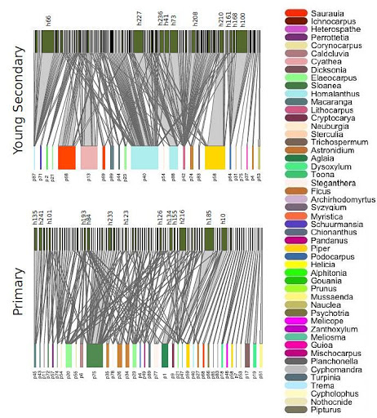
New Guinea Food Webs
Large scale rearing campaigns across multiple forests (secondary, primary, montane, dynamic plots and felling plots)
Many ongoing research programmes (e.g. insect-plant food webs, ecological speciation, canopy ant ecology etc.)
Started in 1994: parataxonomists provide ‘morphospecies’ which are passed to taxonomic experts and DNA barcoded (20,000 records of Lepidoptera to date!)
Interaction networks in 0.2 ha of early secondary and primary forests (plant species at the bottom, caterpillar species on top)
http://baloun.entu.cas.cz/png/#
Redmond et al., 2019. Ecography

Slide 37
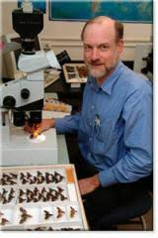
Molecular barcodes inform taxonomy
Match insects and genitalia to published specimens and confirm/investigate cryptic morphology using barcodes
Morphological experts (e.g. Scott Miller at US Natural History Museum)
Two way process => eventually led to high throughput barcoding of many individuals
Dr Scott E. Miller, Smithsonian Institute

Slide 38
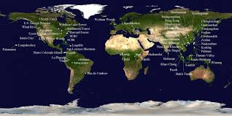
Seed feeding insects across three continents
Programme initiated in 2008/9 to study fruit feeding Lepidoptera (understudied and taxonomically challenging) used DNA barcodes very effectively
Extended to three ForestGEO plots (BCI, Khao Chong and Wanang) to study multiple seed feeding guilds
Complex networks were resolved and compared

Slide 39
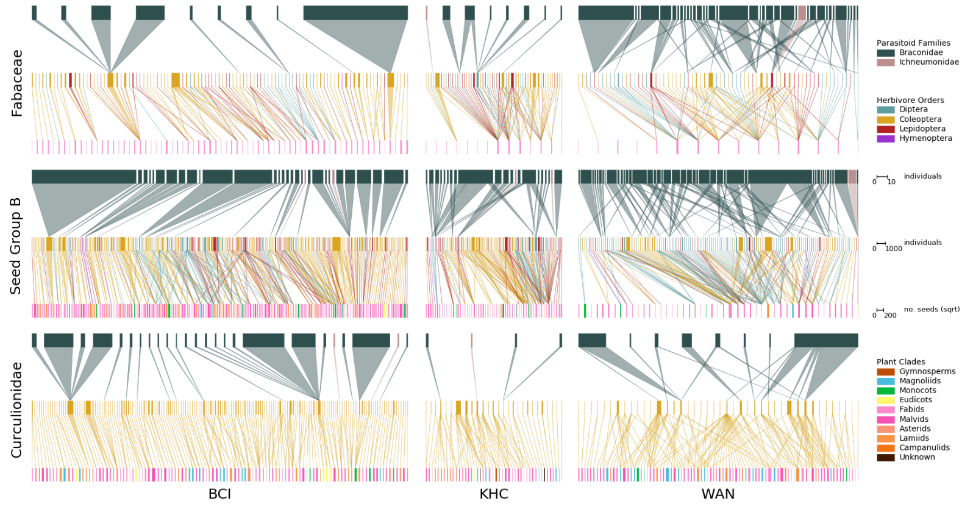
Seed feeding insects
Basset et al., 2018. Oikos.

Slide 40
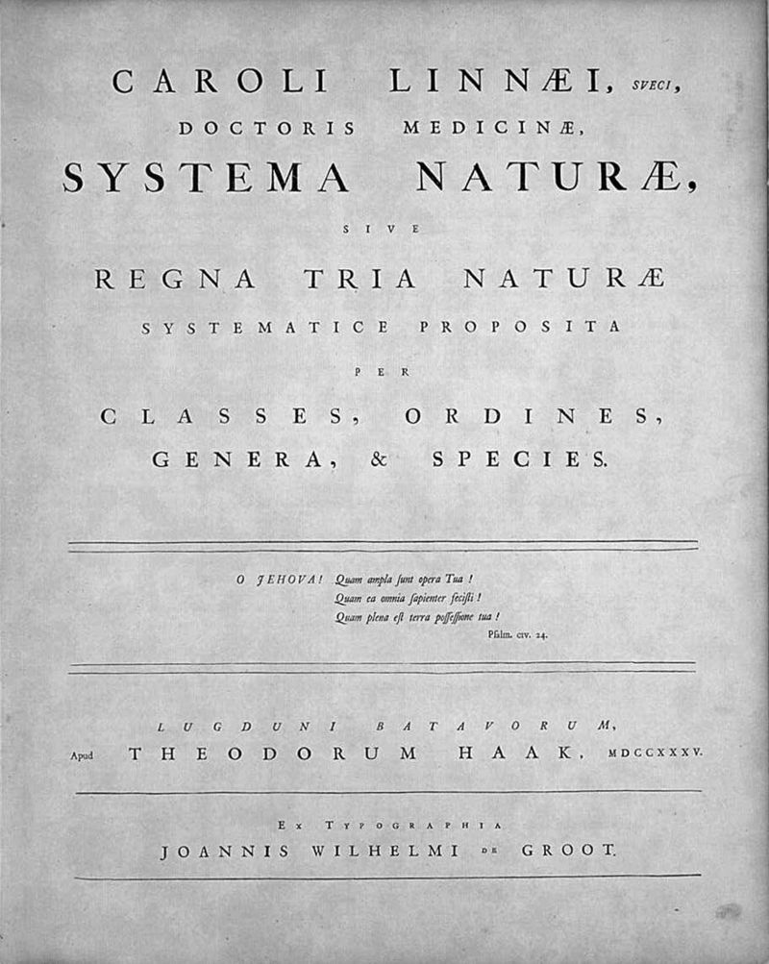
An ode to taxonomy
Good species ID and taxonomy underpin ecological and evolutionary studies of biodiversity and are central to management and conservation.
Molecular and taxonomic methods have advanced our understanding of ecology greatly.
Wheeler et al., 2004. Proc. Roy. Soc. B.

Slide 41
Considerations
The main issue is that it is a single locus approach
Introgression and incomplete lineage sorting
- Hybridisation and backcrossing or incipient species
Nuclear insertions and pseudogenes
Sometimes mtDNA is copied into the nucleus where selection is relaxed => pseudogenes
Wolbachia sweeps
- Spread of Wolbachia in mtDNA linked to spread of genes in mtDNA

Slide 42
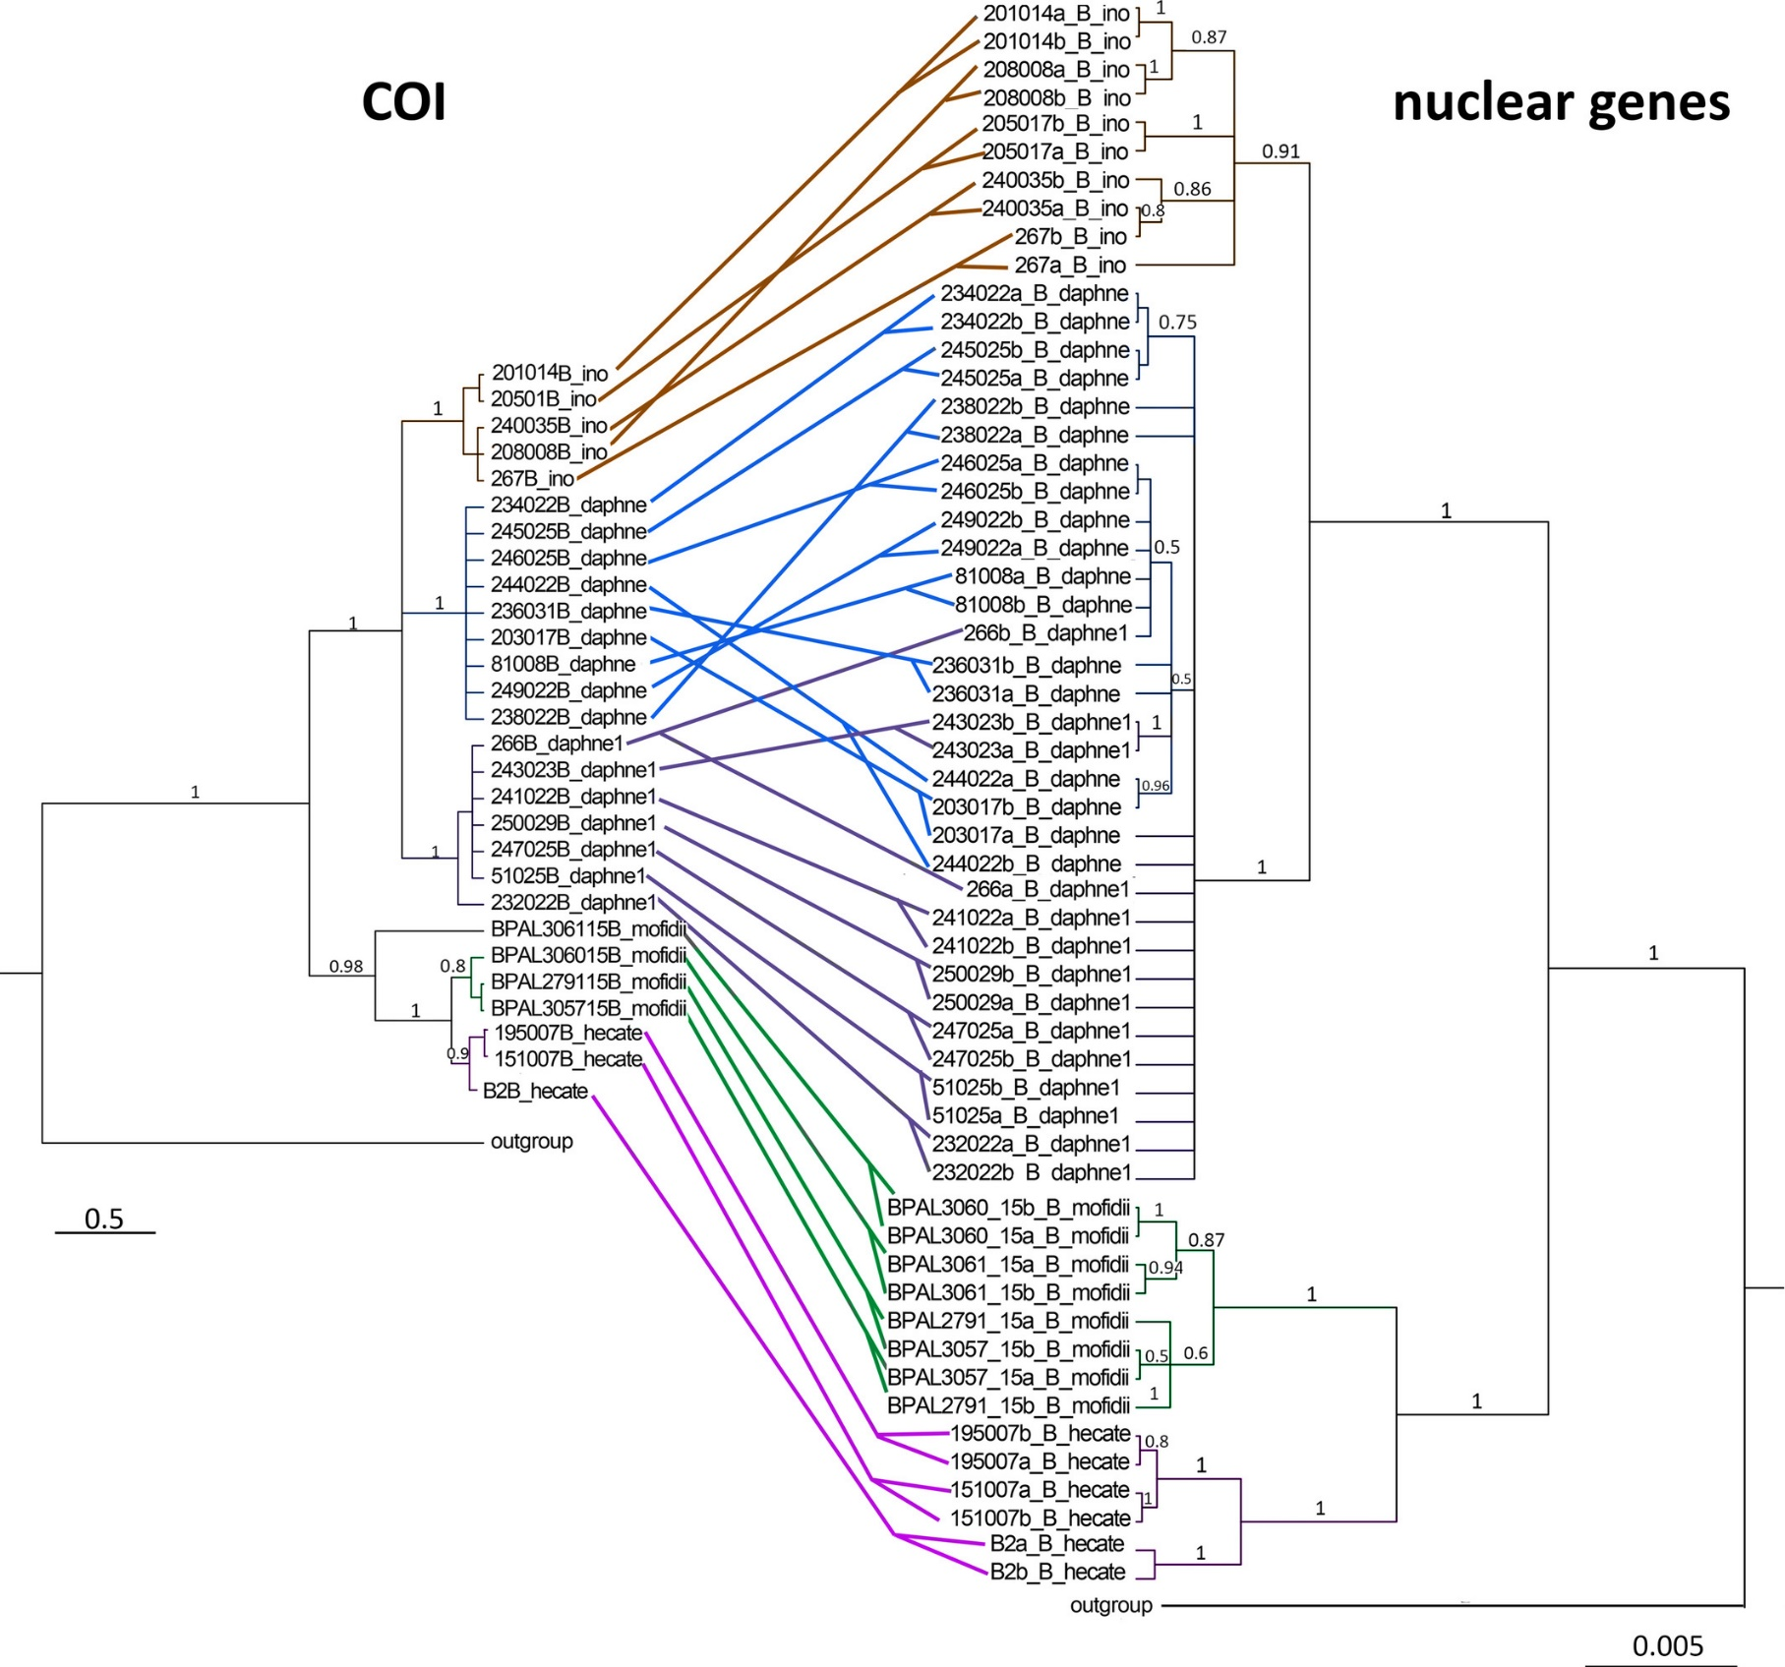
Integration of nuclear DNA (e.g. ITS for insects)
A combination of mtDNA and nucDNA can solve many of these limitations

Slide 43
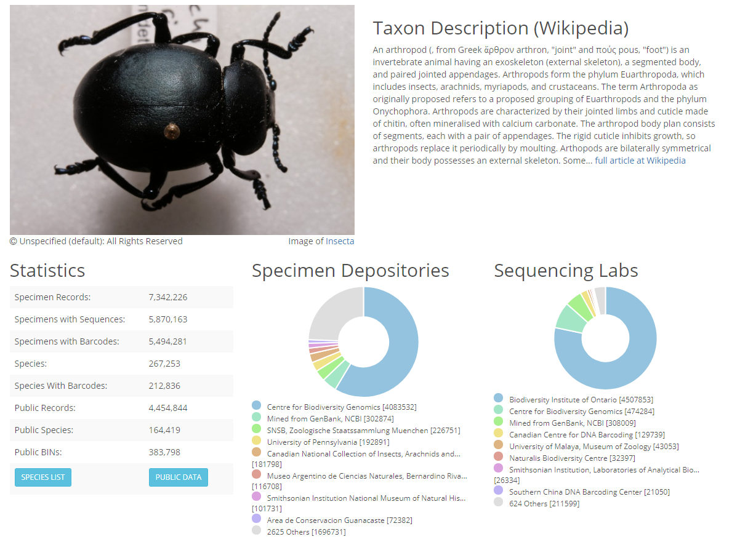
BOLD: Barcoding of Life Data System
DNA barcoding is a taxonomic method that uses a designated portion of a specific gene or genes (proposed to be analogous to a barcode) to identify an organism to species, for example the standard Arthropod barcode is a segment 658 base pair portion of the cytochrome oxidase I (COI) gene and the Internal Transcribed Spacer (ITS) rRNA gene is often used to create barcodes for fungi.
For insects at least a pairwise difference of 2.3% of all base pairs distinguishes species (rule of thumb).
Mitochondrial DNA has a higher mutation rate than nuclear genes making it suitable to distinguish species
http://v4.boldsystems.org/

Slide 44
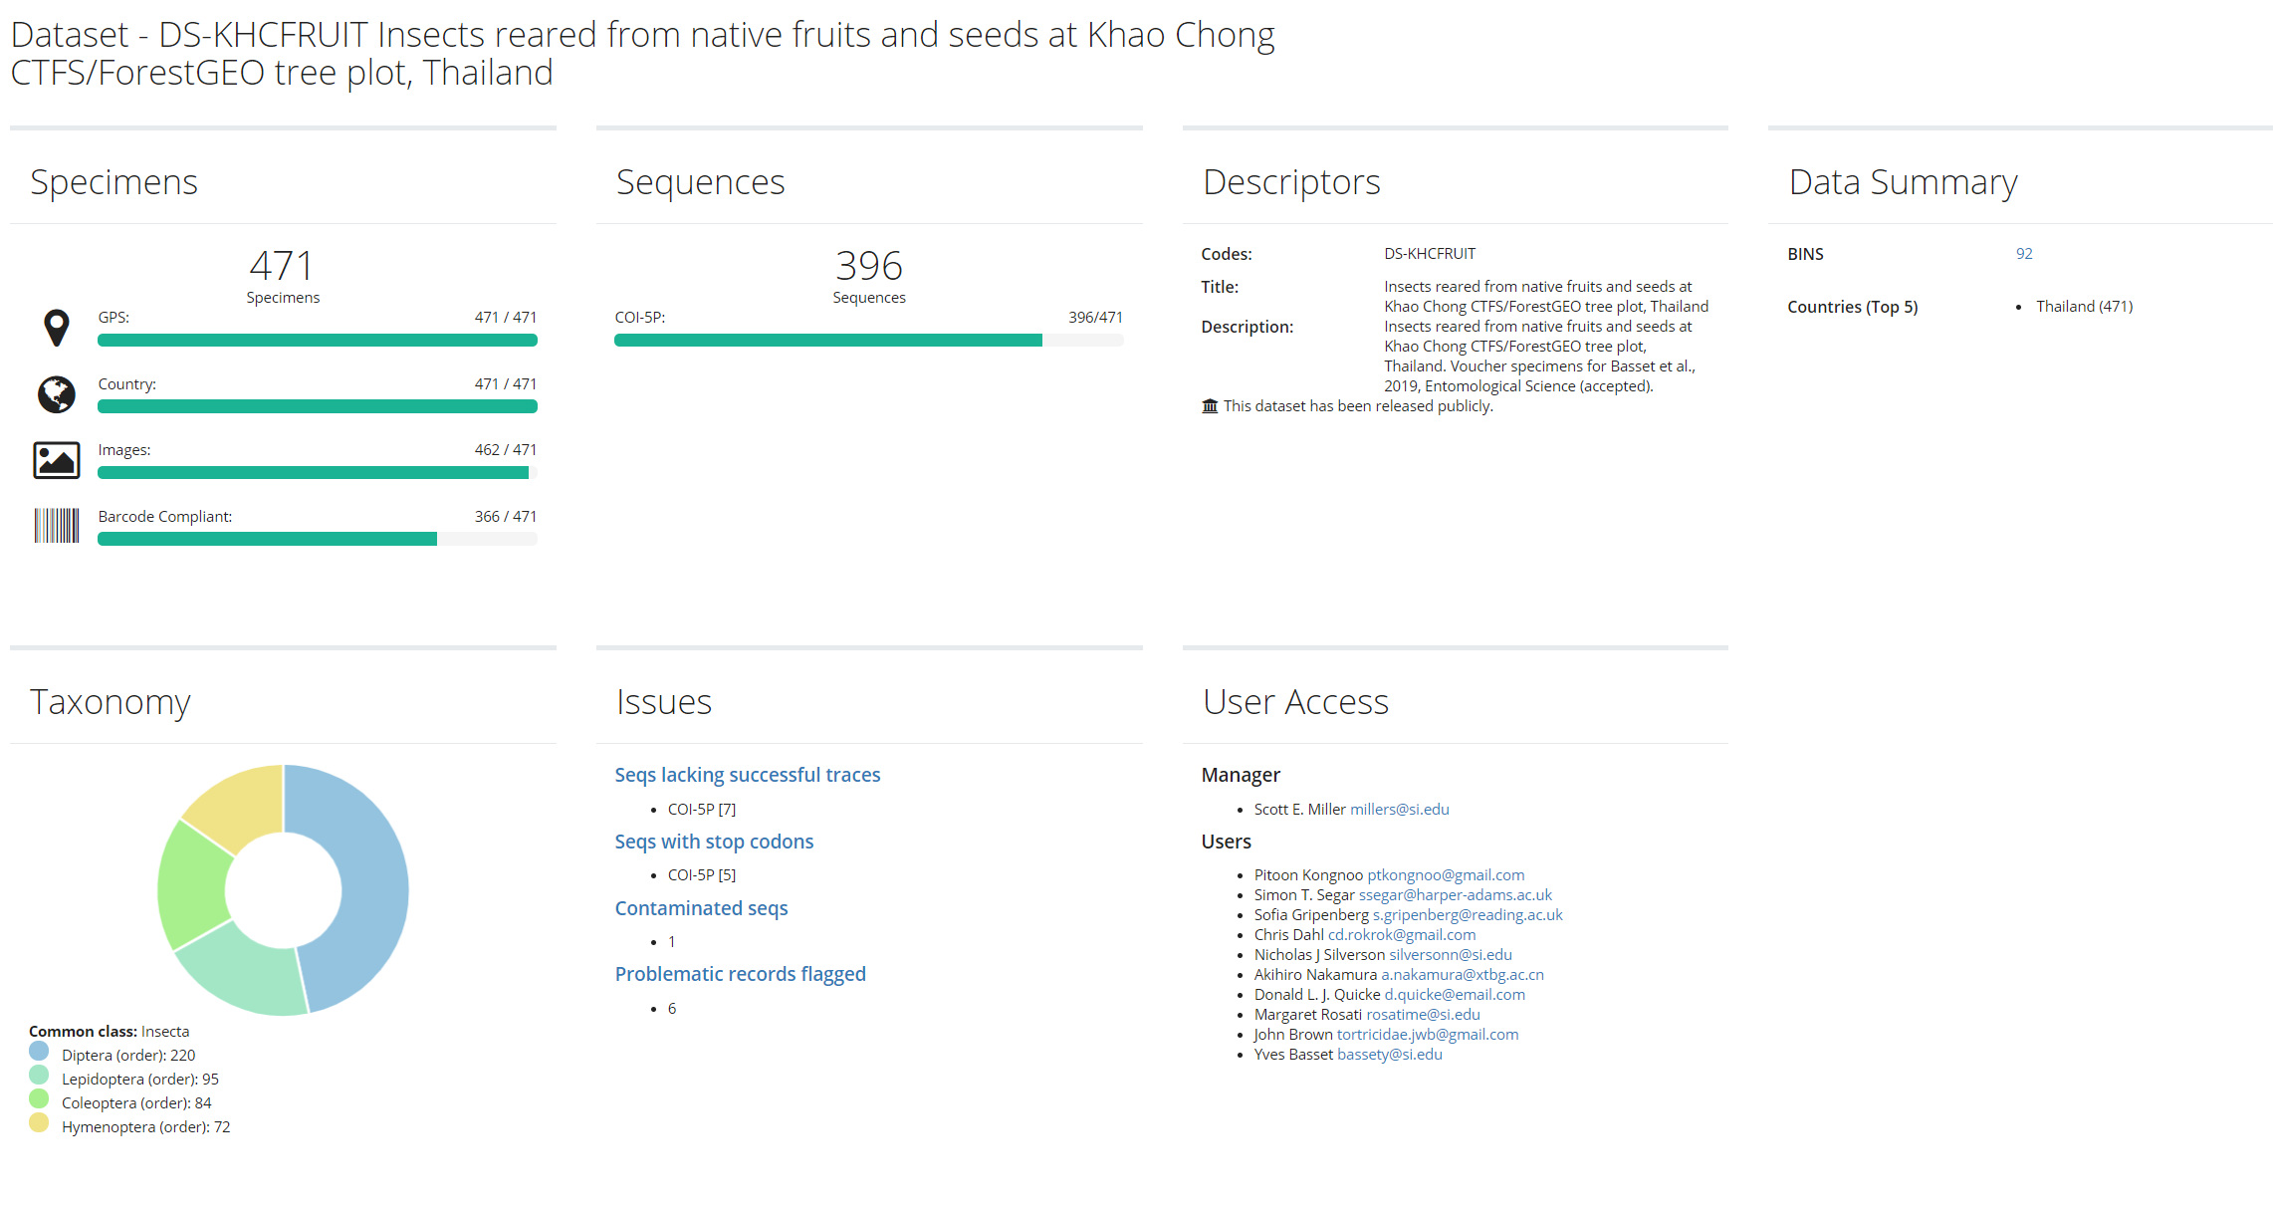
BOLD: An interactive tutorial

Slide 45
Login Details
Student | Username | Old Password | New Password
Shannon Goldberg | ssegar.temp1 | x5kiUZcbe4 | NERC24_Insecta_#1
Dean Joyce | ssegar.temp2 | x5kiUZcbe4 | NERC24_Insecta_#2
Samantha Bishop | ssegar.temp3 | x5kiUZcbe4 | NERC24_Insecta_#3
Charlotte Robb | ssegar.temp4 | x5kiUZcbe4 | NERC24_Insecta_#4
Oliver James Clark-Hattingh | ssegar.temp5 | x5kiUZcbe4 | NERC24_Insecta_#5
Suleiman Mustapha | ssegar.temp6 | x5kiUZcbe4 | NERC24_Insecta_#6
Hannah Risser | ssegar.temp7 | x5kiUZcbe4 | NERC24_Insecta_#7
Rosie McCallum | ssegar.temp8 | x5kiUZcbe4 | NERC24_Insecta_#8
Miles Nesbit | ssegar.temp9 | x5kiUZcbe4 | NERC24_Insecta_#9
Adam Martin | ssegar.temp10 | x5kiUZcbe4 | NERC24_Insecta_#10
Anthony Lowney | ssegar.temp11 | x5kiUZcbe4 | NERC24_Insecta_#11
Lucy Garratt | ssegar.temp12 | x5kiUZcbe4 | NERC24_Insecta_#12
Cameron Hubbard | ssegar.temp13 | x5kiUZcbe4 | NERC24_Insecta_#13
Holly Appleby | ssegar.temp14 | x5kiUZcbe4 | NERC24_Insecta_#14
Sophie Weston | ssegar.temp15 | x5kiUZcbe4 | NERC24_Insecta_#15
Paul O'Hagan | ssegar.temp16 | x5kiUZcbe4 | NERC24_Insecta_#16

Slide 46

Public and private data sets

Slide 47

Additional Features

Slide 48


DNA Metabarcoding
Similar principle to DNA barcoding
The coupling of molecular taxonomy and NGS sequencing
Uses ITS2 DNA region instead of COI
Internal transcribed spacer
Eukaryotes have two region ITS1 and ITS2
Range of applications
Food web analysis, biodiversity profiling, etc.

Slide 49


DNA Metabarcoding

Slide 50

Molecular Phylogenetics
Hypotheses for phylogenetic relationships based on molecular data
Sanger sequencing: 10’s of genes
NGS: hundreds of genes
Phylogenetic hypotheses are central to understanding many ecological and evolutionary patterns and processes, for example:
Community assembly
Network structure
Speciation and the generation of biodiversity
Many more……

Slide 51
References
Basset, Y. et al. (2021) ‘Host specificity and interaction networks of insects feeding on seeds and fruits in tropical rainforests’, Oikos [Preprint].
Hebert, P.D.N. et al. (2004) ‘Ten species in one: DNA barcoding reveals cryptic species in the neotropical skipper butterfly Astraptes fulgerator’, Proceedings of the National Academy of Sciences of the United States of America, 101(41), p. 14812.
Hubert, N. and Hanner, R. (no date) ‘DNA Barcoding, species delineation and taxonomy: a historical perspective’, p. 15.
Souto-Vilarós, D. et al. (2019) ‘Faster speciation of fig-wasps than their host figs leads to decoupled speciation dynamics: Snapshots across the speciation continuum’, Molecular Ecology, 28(17), pp. 3958–3976. Available at: https://doi.org/10.1111/mec.15190.
Toju, H. and Baba, Y.G. (2018) ‘DNA metabarcoding of spiders, insects, and springtails for exploring potential linkage between above- and below-ground food webs’, Zoological Letters, 4(1). Available at: https://doi.org/10.1186/s40851-018-0088-9.
Wheeler, Q.D. (2004) ‘Taxonomic triage and the poverty of phylogeny’, Philosophical Transactions of the Royal Society of London. Series B: Biological Sciences. Edited by H.C.J. Godfray and S. Knapp, 359(1444), pp. 571–583. Available at: https://doi.org/10.1098/rstb.2003.1452.

